Slide 1
Unit No 3
Memory and Peripherals interfacing

Slide 2
3.1 Memory Interfacing - RAM and ROM Decoding Techniques – Partial
and Absolute
3.2 8255(PPI)-(Programmable peripheral interface )
Block diagram, CWR, operating modes, interfacing with
8086.
3.3 8257-(DMAC)-(Direct memory access with DMA controller )
Block diagram, DMA operations and transfer modes.
3.4 8259(PIC)- (Programmable Interrupt Controller )
Block Diagram, Interfacing the 8259 in single and cascaded
mode.

Slide 3
3.1 Memory Interfacing - RAM and ROM Decoding Techniques – Partial and Absolute
In this module you will learn
1.what are the different types of memory
2.Memory structure & its requirement.
3.How to interface RAM & ROM with 8086 in minimum &
maximum mode.
4.Different types of addressing decoding.

Slide 4
Introduction
Memory is simply a device that can be used to store the information .
The semiconductor memories are extensively used because of their small size ,low cost ,high speed,high reliability & case of expansion of the memory size
It consist of mainly flip flop & some additional circuitry such as buffers ,one flip flop can hold one bit of data .

Slide 5
Memory Fundamental
Memory capacity :The no. of bits that a semiconductor memory chip can
store is called its chip capacity.
Memory Organization: Each memory chip contains 2N locations,
where N is the no. of address pins on the chip.
Each location contains M bits, where M is the no. of data pins on the chip. The entire chip will contain 2N x M bits.
E.g. for 4K x 4, 212 =4096 locations, each location holding 4 bits, so N=12 & M=4.

Slide 6
In the 8086 microprocessor, memory can be classified into static memory and dynamic memory based on how it is allocated and managed.
1. Static Memory
Definition: Memory that is allocated at the time of compilation and does not change during execution.
Characteristics:
Fixed size and location.
Typically includes code, constants, and global/static variables.
Faster access since no dynamic allocation overhead.
Uses SRAM (Static RAM), which retains data as long as power is supplied.
Examples:
Code segment (CS) where program instructions are stored.
Data segment (DS) for global and static variables.
Stack segment (SS) for function calls and local variables.
2. Dynamic Memory
Definition: Memory that is allocated during program execution and can change as required.
Characteristics:
Flexible and efficient usage of memory.
Typically stored in heap or dynamically managed areas.
Requires explicit allocation and deallocation (in higher-level languages, but not directly in 8086 assembly).
Uses DRAM (Dynamic RAM), which requires periodic refreshing.
.

Slide 7
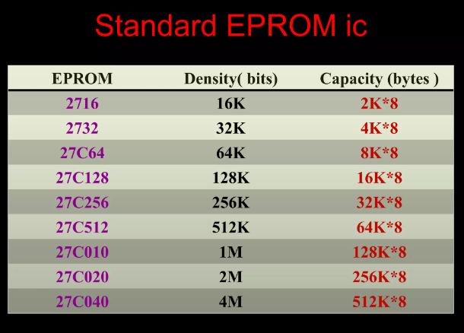

Slide 8
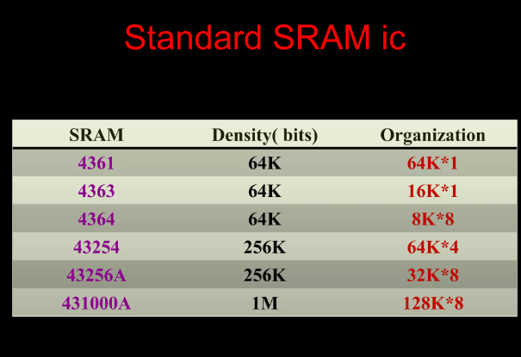

Slide 9
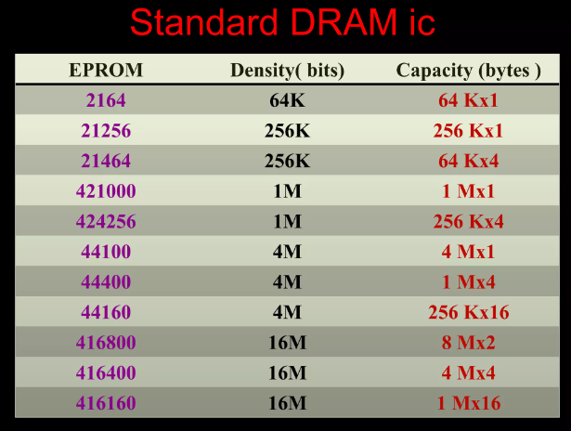

Slide 10
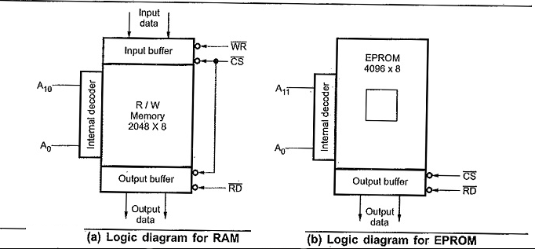
MEMORY STRUCTURE

Slide 11
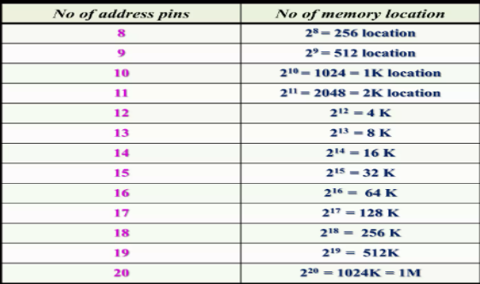
PHYSICAL STRUCTURE OF PRACTICAL MEMORY IC
1. Address Pins:
2. Data pins:
Number of flip flop in each location is 4/8, then data pins 4/8.
3. Control pins:
ROM/ EPROM will consist of only RD (OE) RAM will have control pins RD & WR.
4. Commons pins: CS (chip select) .
CS is generated using: i. NAND gate
ii. 3 to 8 decoder
iii. PAL IC

Slide 12
Address decoding
• In general all the address lines are not used by the memory devices to select particular memory locations. • The remaining line are used to generate chip select logic.
• Following two techniques are used to decode the address:
1) Absolute or Full decoding 2) Linear or Partial decoding
Absolute or full decoding
• All the higher address lines are decoded to select the memory chip.
• The memory chip is selected only for the specified logic levels on these higher order address lines.
• So each location have fixed address.
• This technique is expensive
• It needs more hardware than partial decoding.
Partial decoding Or Linear Decoding
• This technique is used in the small
system
• All the address lines are not used to generate chip select logic
• Individual High order address lines are used to decode the chip select for the memory chips.
• Less hardware is required
. • Drawback is address of location is not fixed, so each location may have multiple address.

Slide 13
Absolute decoding VS Partial Decoding
ABSOLUTE DECODING
Absolute decoding is a method of address decoding in which a specific and fixed address range is assigned to a peripheral device or memory module. This means that only a particular device will respond when the processor accesses that memory address. How It Works: The 8086 processor generates a 20-bit address (since it has a 1MB memory space). In absolute decoding, all address lines are used to uniquely identify a memory or I/O device. The memory or I/O device is activated only when the exact address match occurs. This method ensures that no two devices share the same address range, avoiding conflicts.

Slide 14
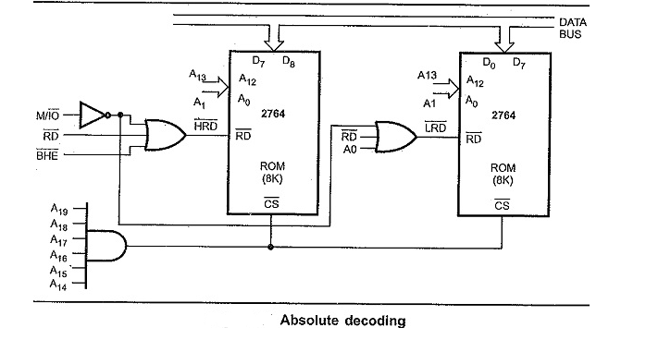
Control signals BHE and A₀ are used to enable outputs of odd and even memory banks respectively.
As each memory chip has 8K memory locations, thirteen address lines are required to address each locations, independently.
All remaining address lines are used to generate an unique chip select signal. This addressing technique is normally used in large, memory systems.

Slide 15
Partial decoding is a memory address decoding technique in which only a few address lines are used to select a device, rather than decoding the full 20-bit address. This method reduces hardware complexity but may lead to address aliasing (overlapping address ranges).
How Partial Decoding Works:
The 8086 generates a 20-bit address (A0–A19).
In partial decoding, only the higher address lines (e.g., A19–A15) are used to select a device.
The lower address lines are not fully decoded, which means the same device may respond to multiple address ranges.
This method is used to save hardware components (like decoders and address comparators).

Slide 16
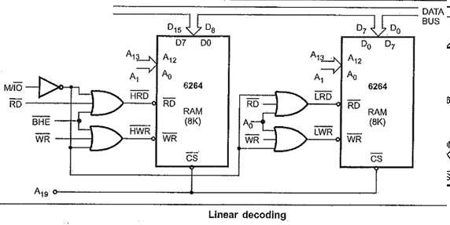
Control signals BHE and A0 are used to, enable odd and even memory banks, respectively.
The address line A19 is used to select the RAM chips. When A19 is low, chip is selected, otherwise it is disabled.
The status of A14 to A18 does not affect the chip selection logic.
This gives you multiple addresses (shadow addresses).
This technique reduces the cost of Address Decoding Techniques in 8086 Microprocessor circuit, but it has drawback of multiple addresses.

Slide 17
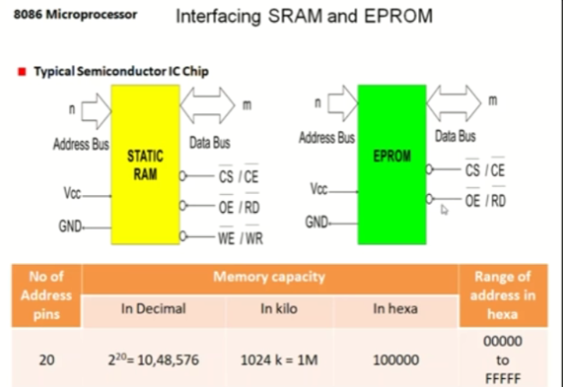

Slide 18
Memory interfacing involve three different tasks such as selection of the required chip, identify the required register and enable the appropriate buffers.
The number of address lines indicates the total memory capacity of the memory device. 1K memory requires 10 address lines A0-A9. Similarly a 1MB requires 20 lines A0-A19.
Memory devices may contain one or more inputs which are used to select the memory device or to enable the memory device. This pin is denoted by CS (Chip select) or CE (Chip enable). When this pin is at logic '0' then only the memory device performs a read or a write operation. If this pin is at logic ‘1’ the memory chip is disabled. If there are more than one CS input then all these pins must be activated to perform read or write operation.
All memory devices will have one or more control inputs. When ROM is used , OE (output enable) pin allows data to flow out of the output data pins. To perform this task both CS and OE must be active. A RAM contains one or two control inputs. They are R /W or RD and WR . If there is only one input R/W then it performs read operation when R/W pin is at logic 1. If it is at logic 0 it performs write operation.

Slide 19
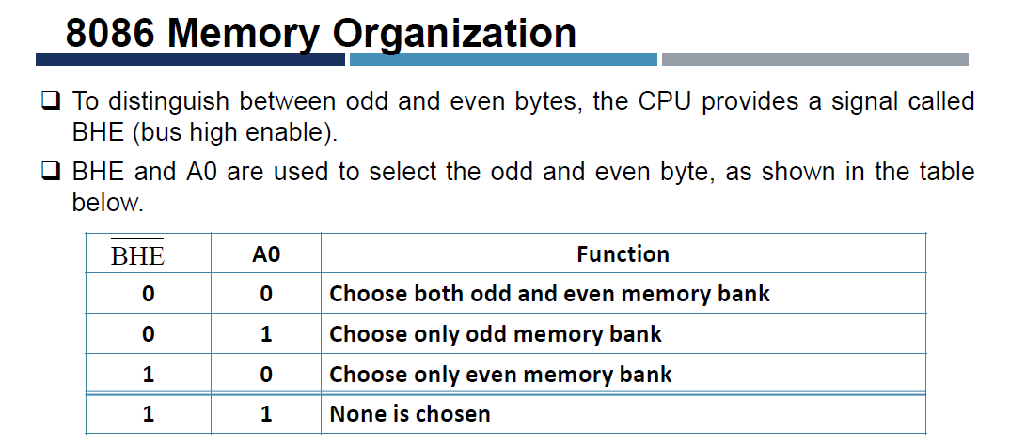

Slide 20
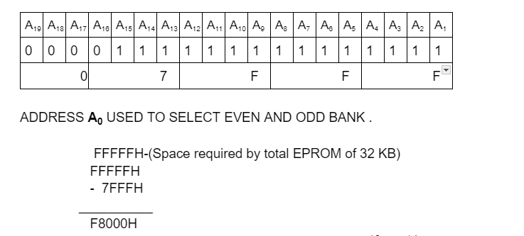
Q.Design an 8086 based Maximum Mode system working at 6 MHz having the following
1)32KB EPROM using 16 KB chips
2) 128KB RAM using 32 KB chips.
Answer: STEP I: Memory Calculation: (A) EPROM
Required =32 KB Available =16KB
No of chips = Required /Available =32KB/16KB=2 chips
Starting address of EPROM is calculated as:
FFFFFH-(Space required by total EPROM of 32 KB)
Calculation of space required by total EPROM of 32 KB = 32 * 1 KB=2⁵*2¹⁰ =2¹⁵
3.Size of a single EPROM chip =16KB ==16 * 1 KB=2⁴*2¹⁰ =2¹⁴
14 address line used =( A_{14…….} A₁₎

Slide 21
(B) RAM
Required =128 KB
Available =32 KB
1. No of chips = Required /Available =128 KB/32 KB=4 chips
2.Starting address of RAM is : 00000H
3.Size of a single RAM chip =32 KB ==32 * 1 KB=2⁵*2¹⁰ =2¹⁵
15 address line used =( A_{15…….} A₁₎
 | EPROM | RAM
Required/Available | 32KB/16 KB | 128Kb/32KB
1.No of chips | 2 | 4
2.Starting address of | F8000H | 00000H
3.Size of a single chip | 14 address line used = ( A_{14…….} A₁₎ | 15 address line used = ( A_{15…….} A₁₎

Slide 22
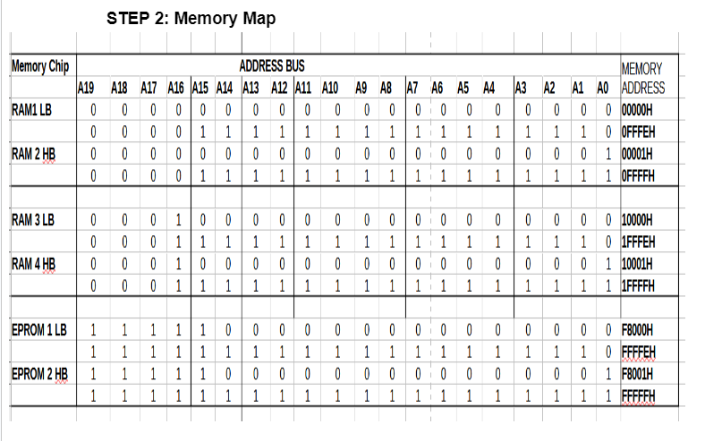

Slide 23
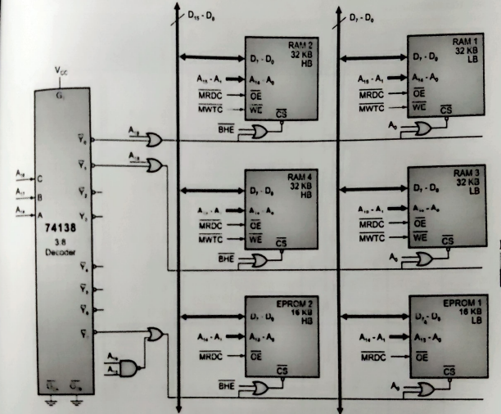
STEP 3: Memory Diagram

Slide 24
Example :
Interface two 4K*8 EPROM chip & two 4K*8 RAM chip using with 8086
Solution:
1.No of chip required : 2
2.Available memory : 4k EPROM 4K RAM
Required memory : 8K EPROM 8K RAM
3. Starting address EPROM RAM :00000H
FFFFFH
- 01FFFH
FE000H

Slide 25
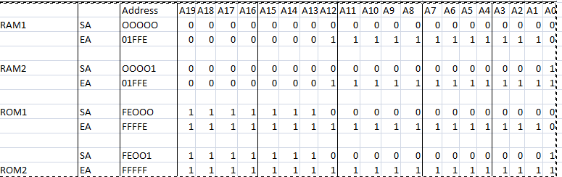
Memory Mapping

Slide 26
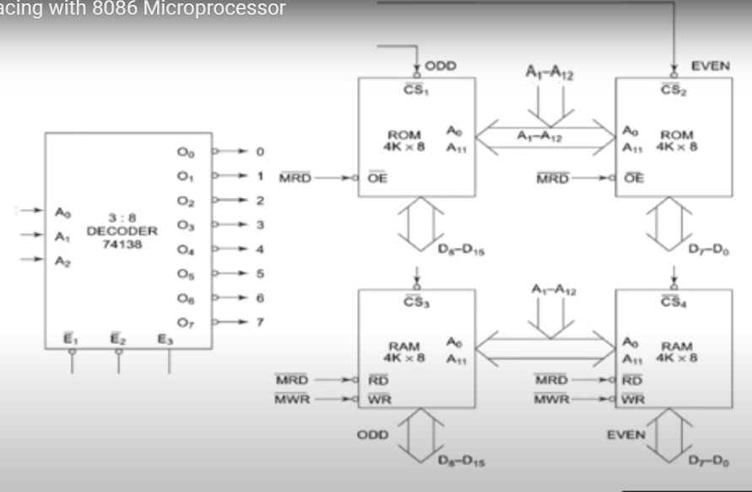

Slide 27
Design a 8086 microprocessor based on following specification
1. MP 8086 working at 10 KHz minimum mode. 2 32 KB ROM using 8 KB devices.
3 16 KB RAM using 4KB chips
Solution:
STEP I: Memory Calculation:
EPROM
Required =32 KB
Available =8KB
1.No of chips = Required /Available =32KB/8KB= 4chips
2.Starting address of EPROM is calculated as:
FFFFFH-(Space required by total EPROM of 32 KB)
Calculation of space required by total EPROM of 32 KB = 32 * 1 KB=2⁵*2¹⁰ =2¹⁵
3.Size of a single EPROM chip =8KB ==8 * 1 KB=2³*2¹⁰ =2¹³
14 address line used =( A_{12…….} A₁₎

Slide 28
RAM
Required =16 KB
Available =4 KB
1. No of chips = Required /Available =16 KB/4 KB=4 chips
2.Starting address of RAM is : 00000H
3.Size of a single RAM chip = 4KB ==4 * 1 KB=2²*2¹⁰ =2¹²
14 address line used =( A_{11…….} A₁₎

Slide 29
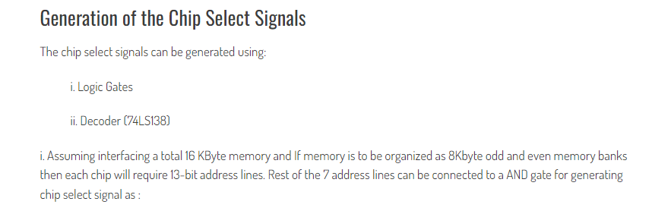
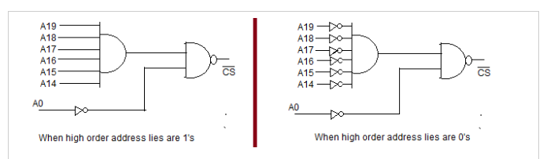

Slide 30
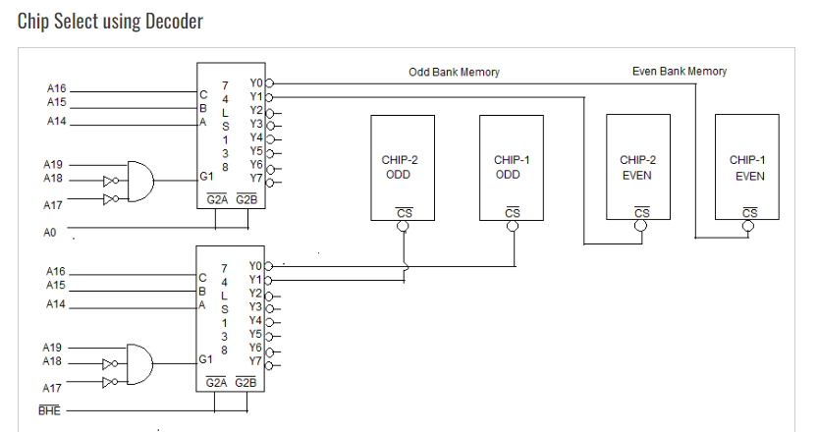

Slide 31
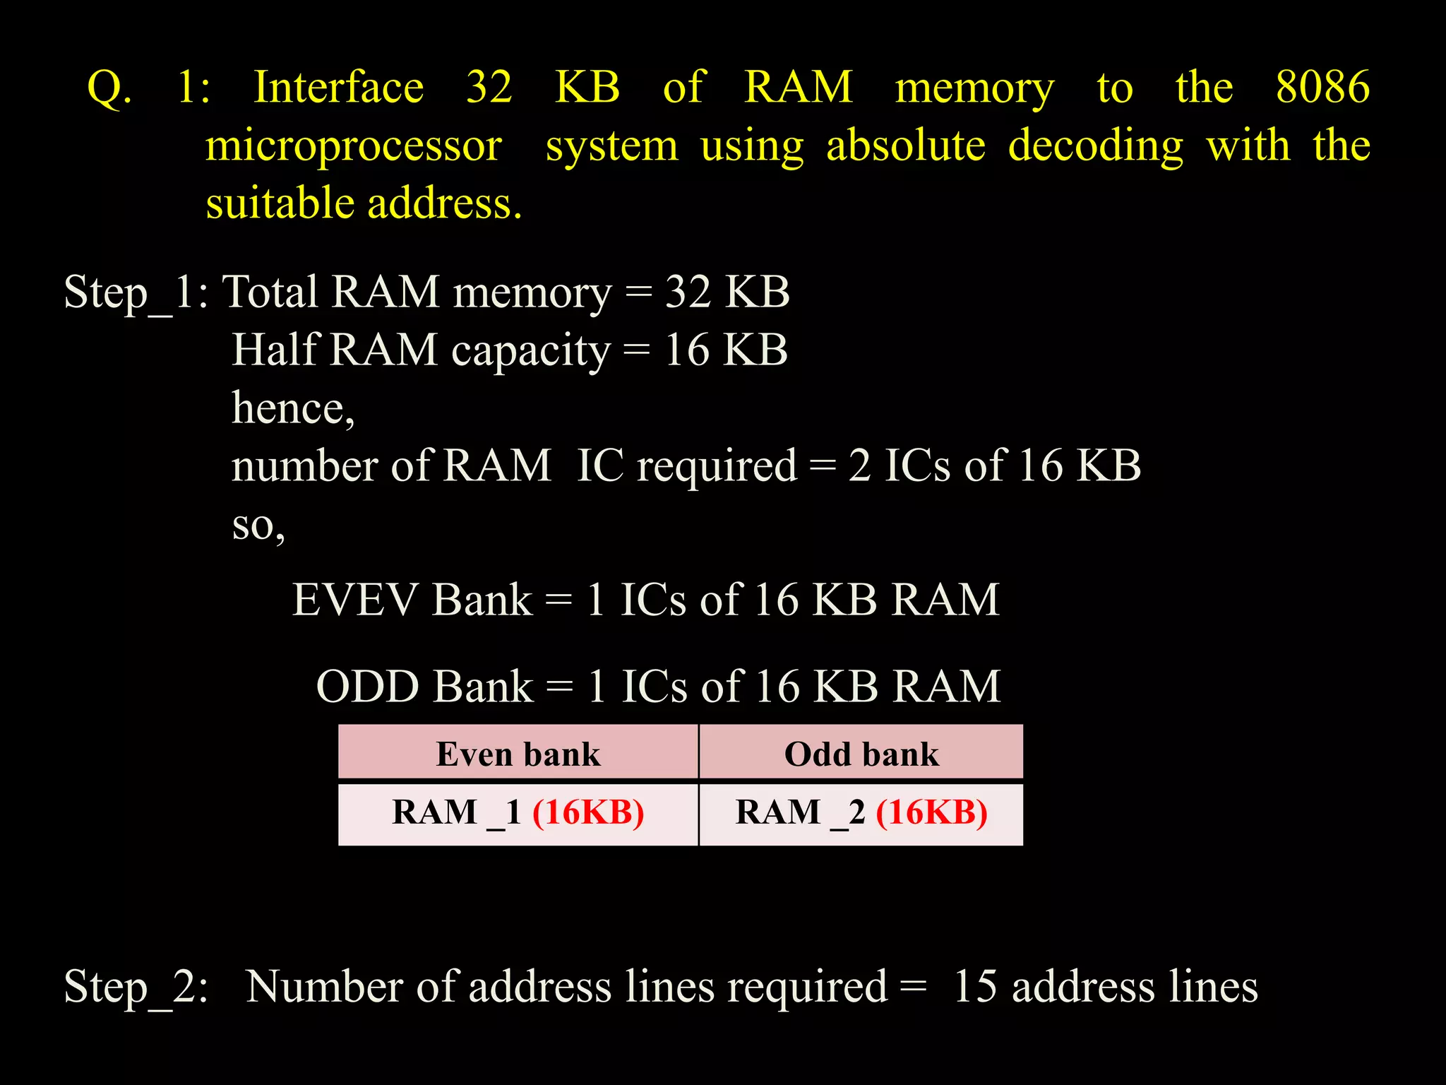

Slide 32
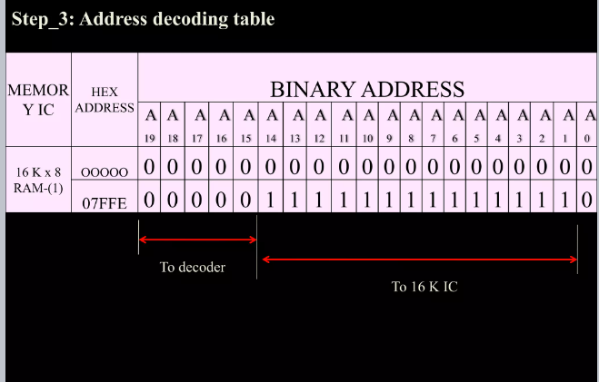

Slide 33
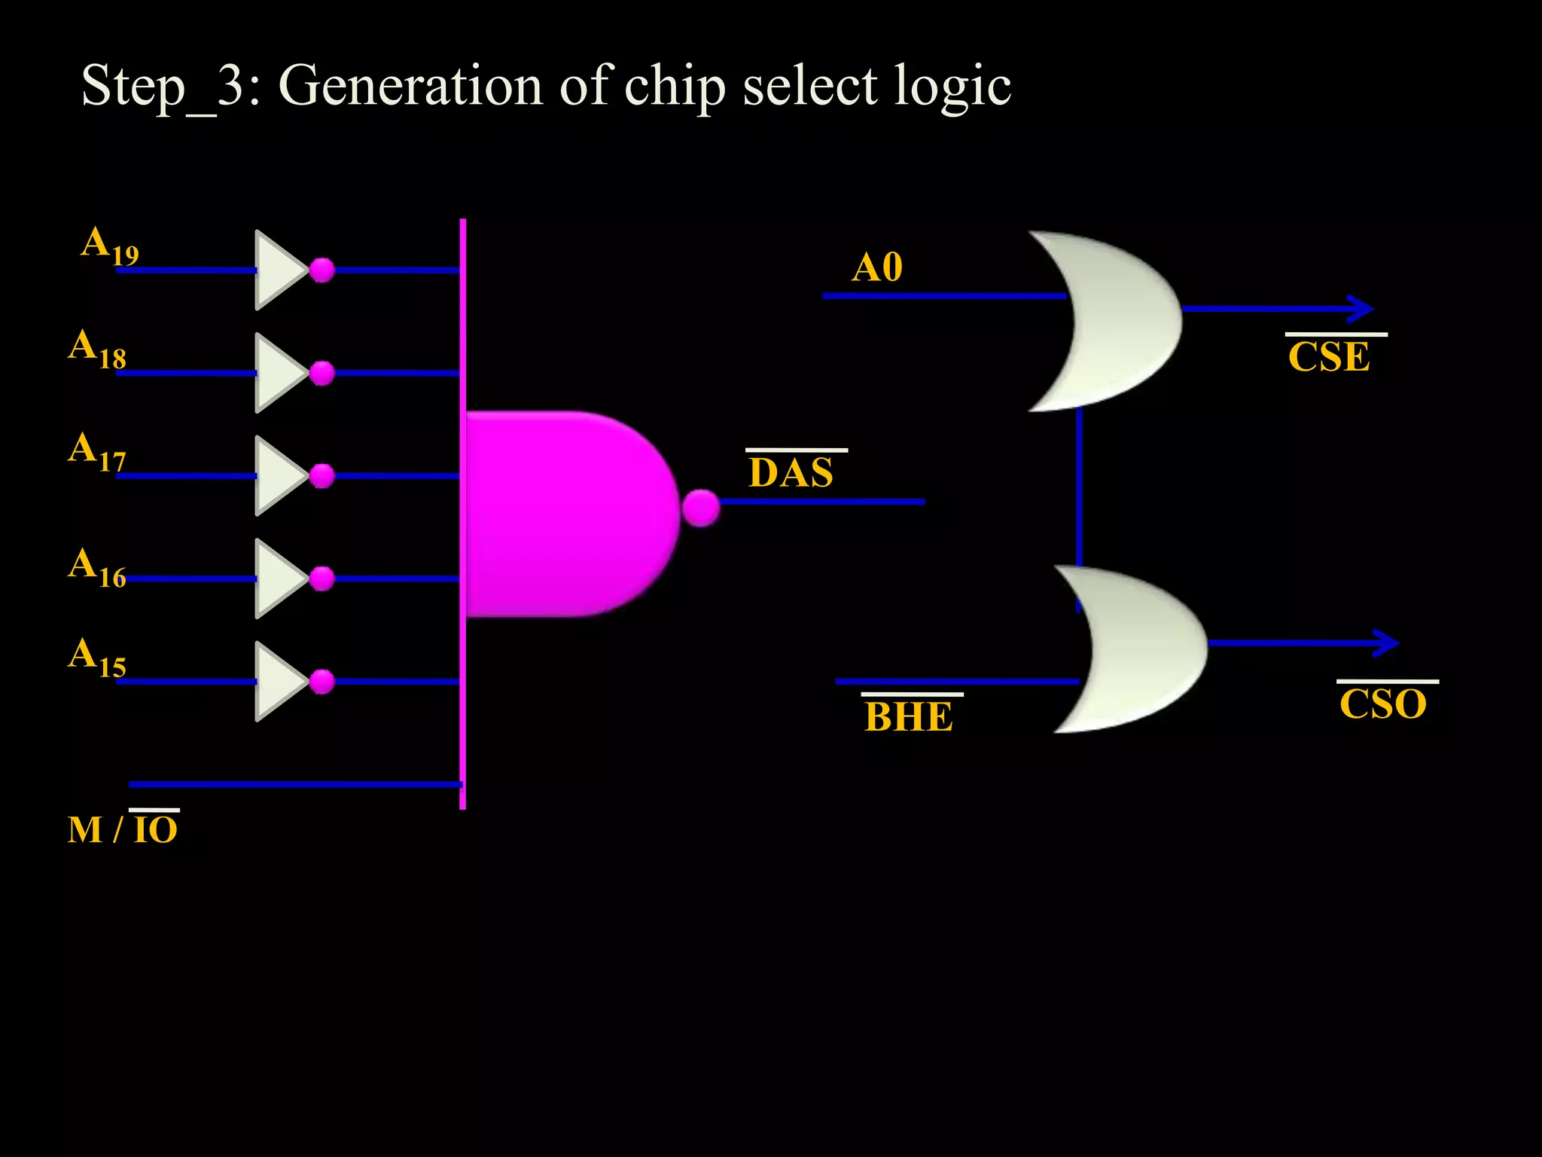

Slide 34
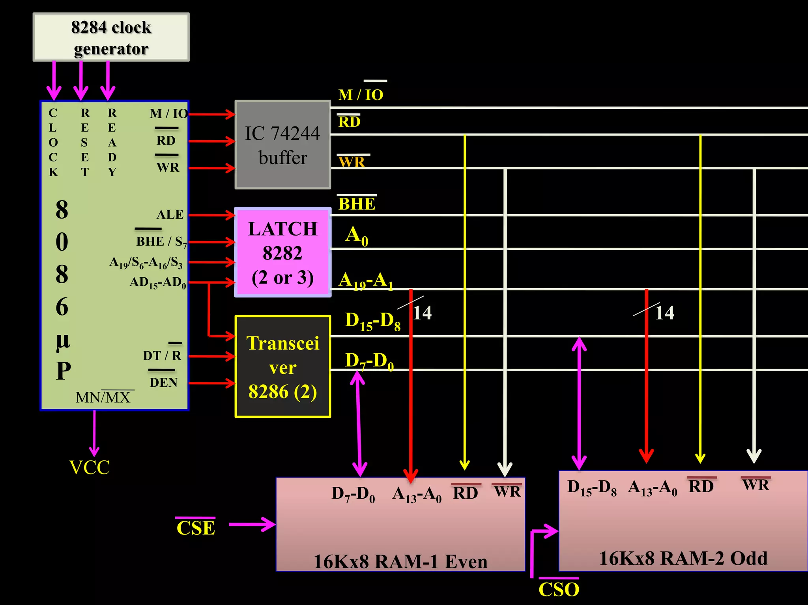

Slide 35
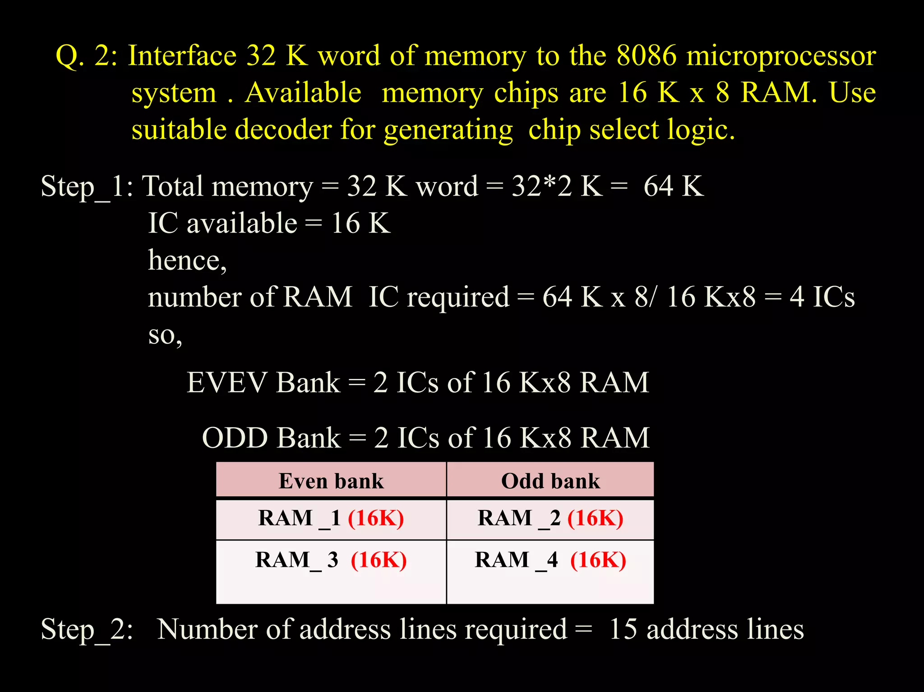

Slide 36
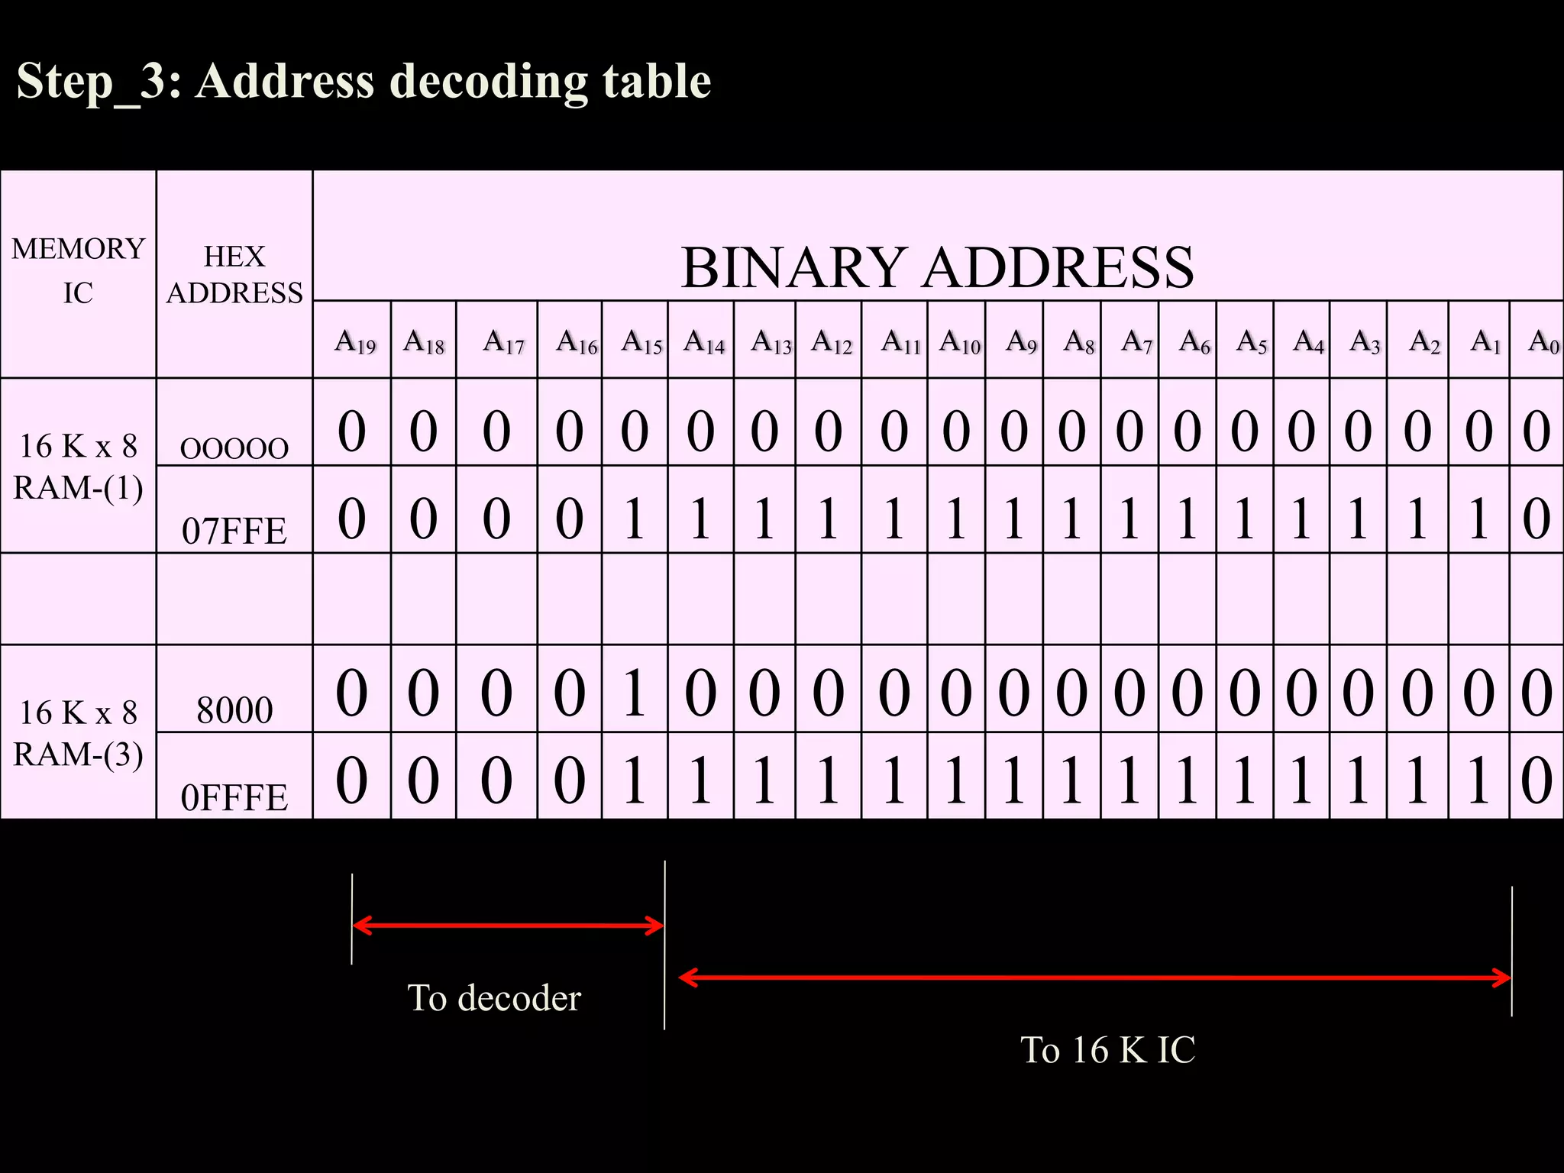

Slide 37
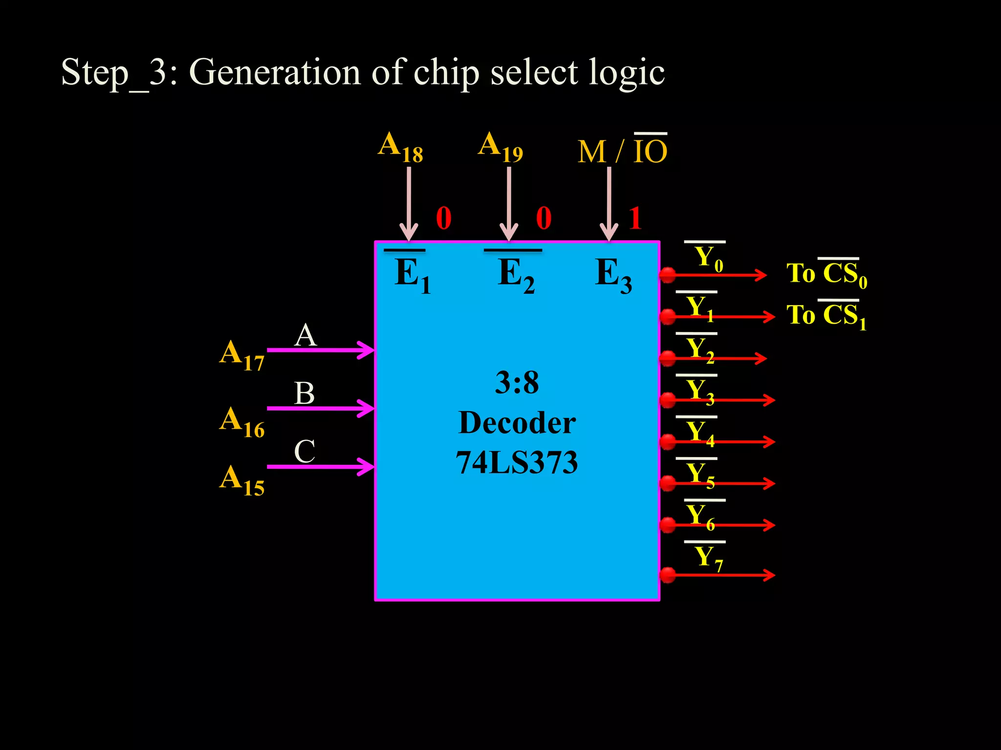

Slide 38
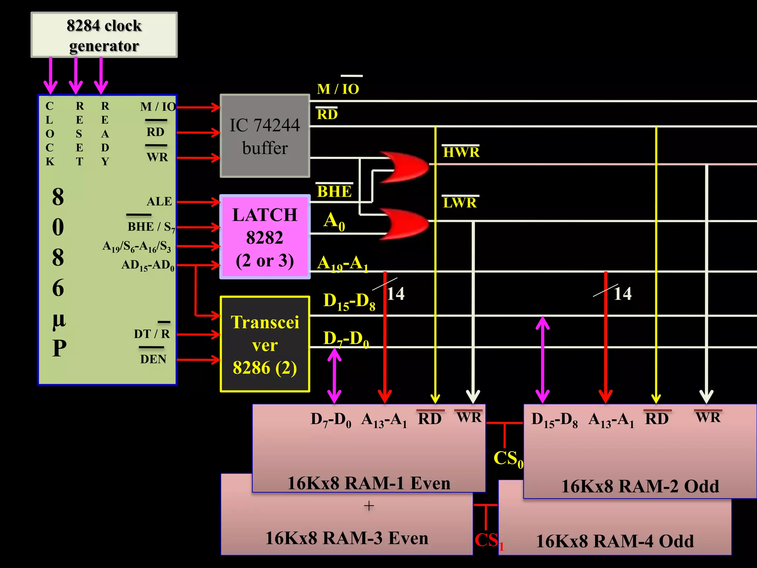

Slide 39
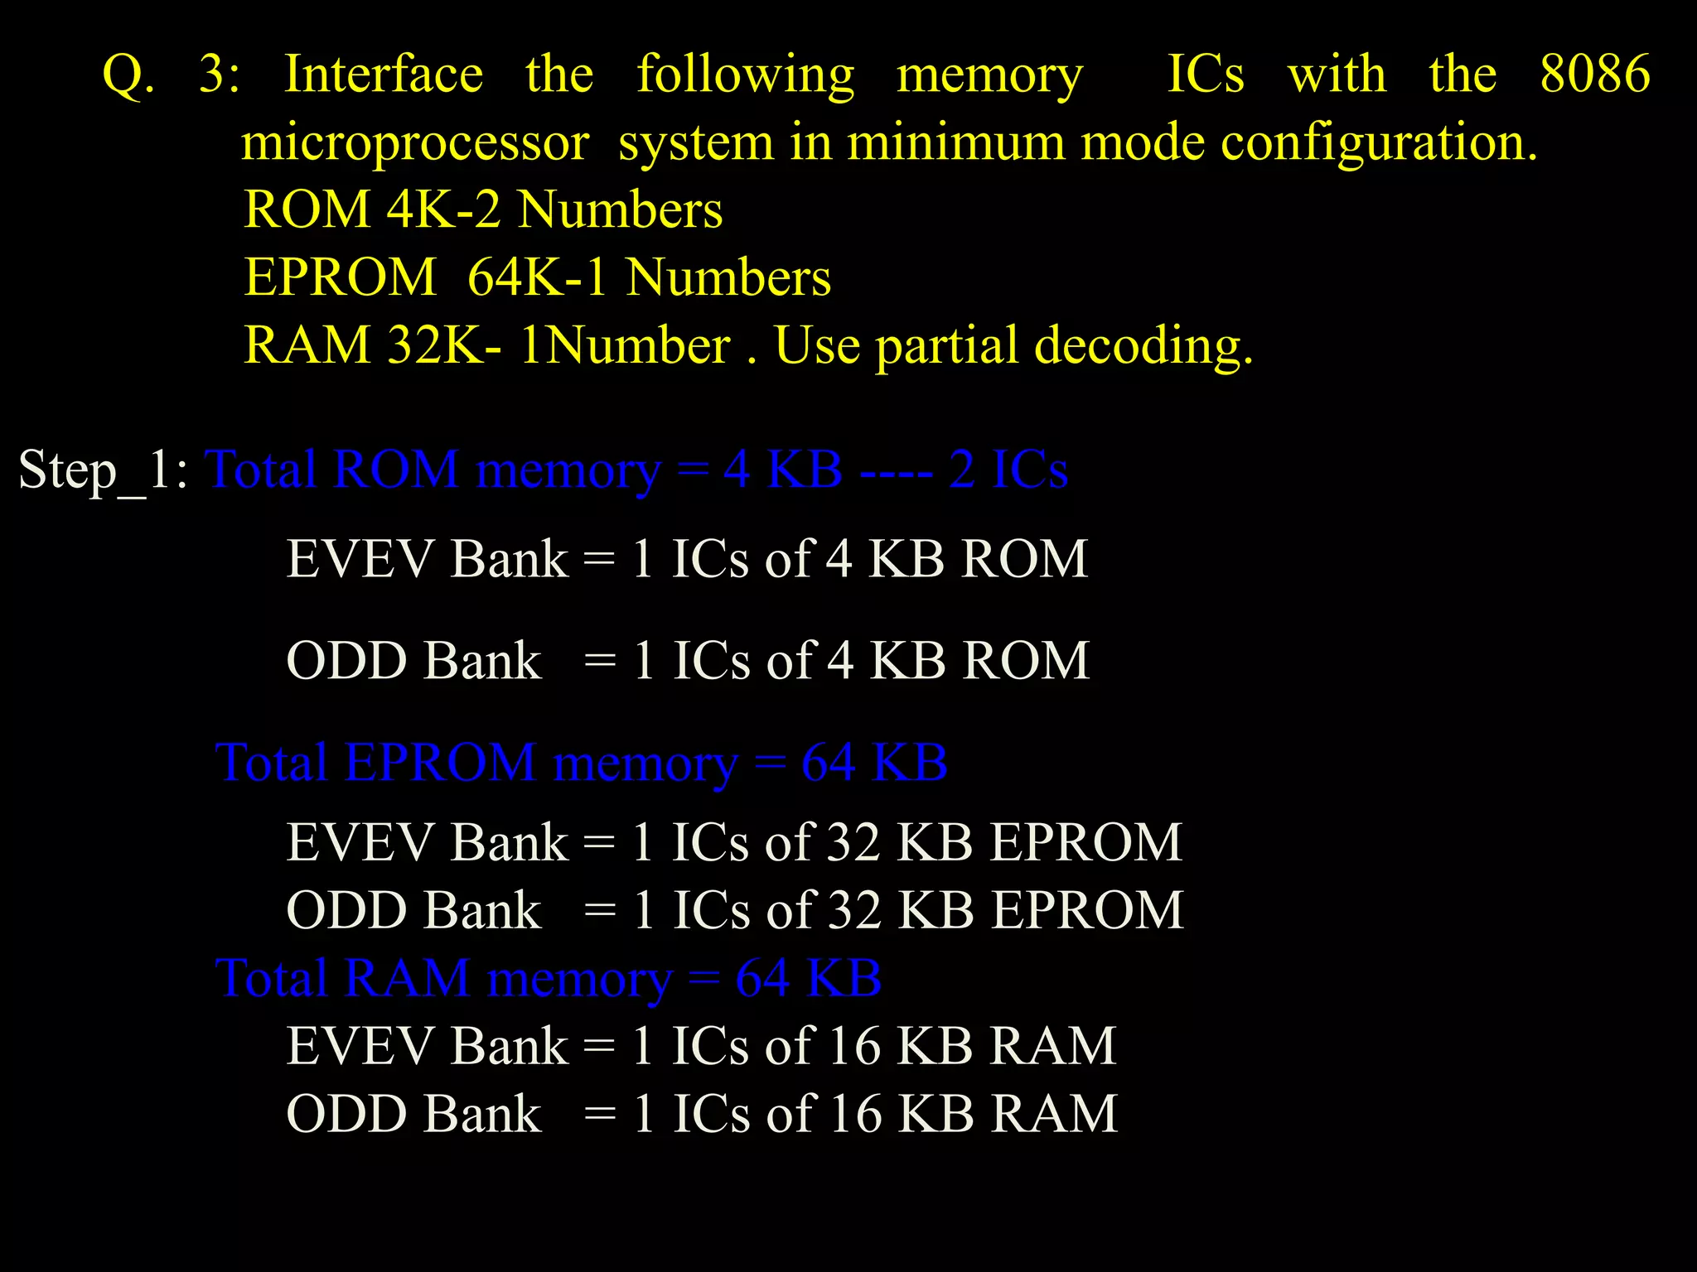

Slide 40
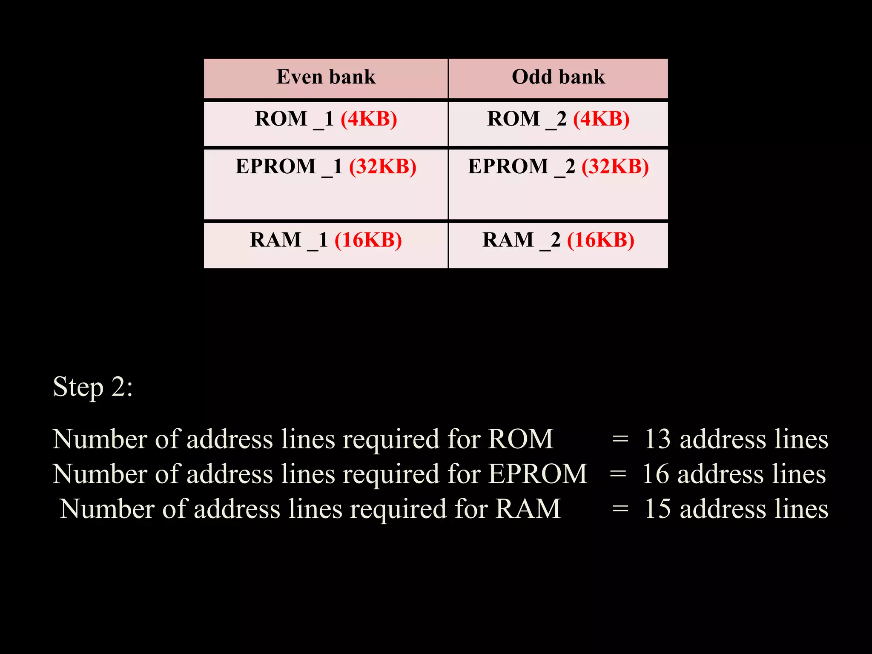

Slide 41
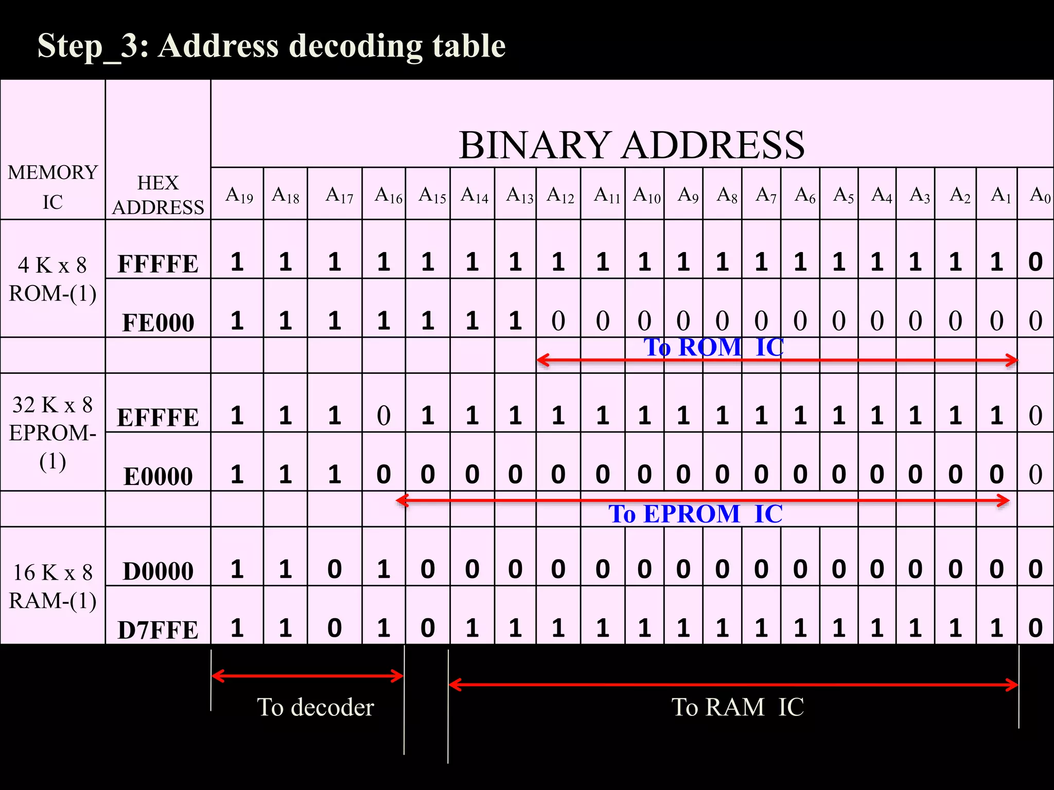

Slide 42
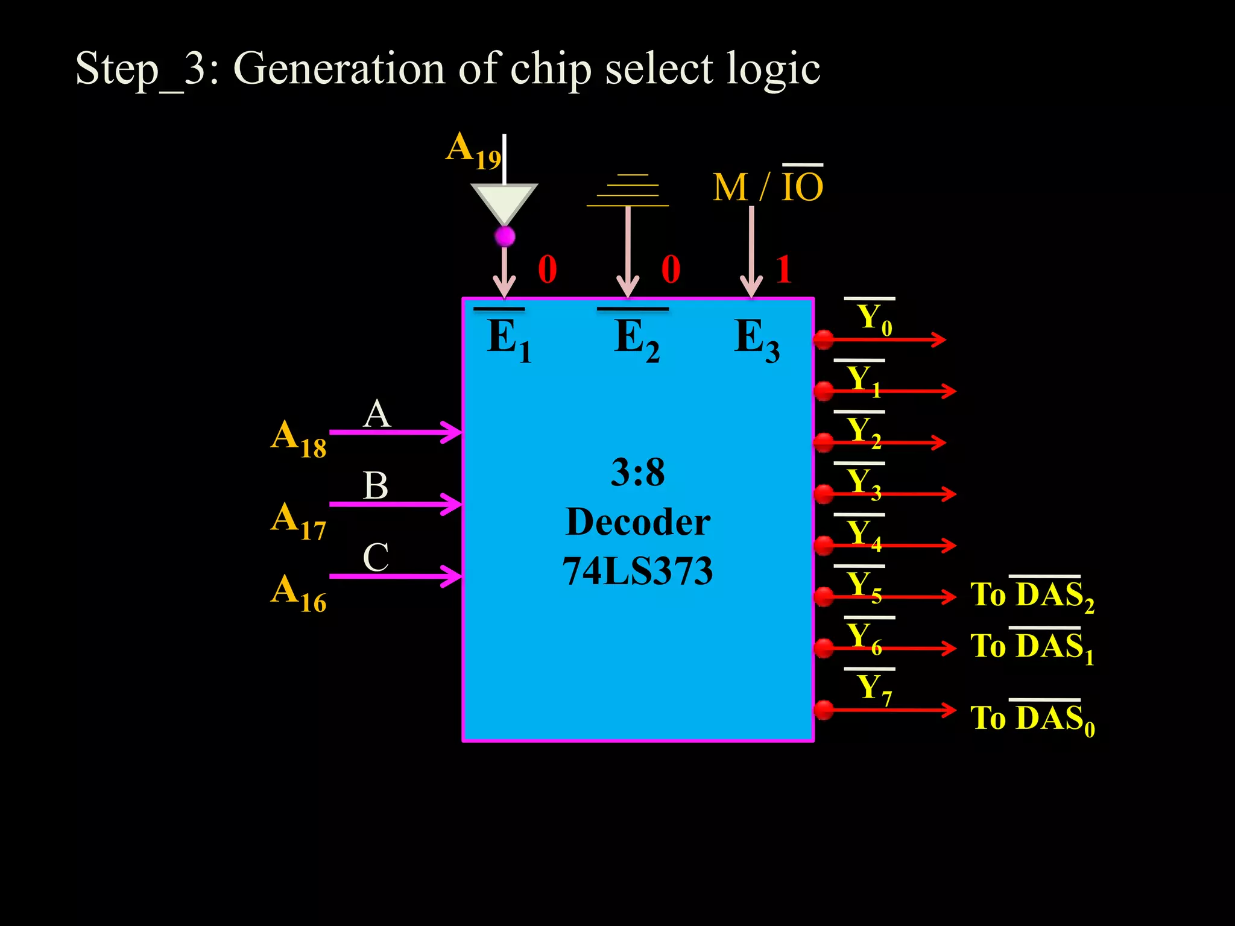

Slide 43


Slide 44
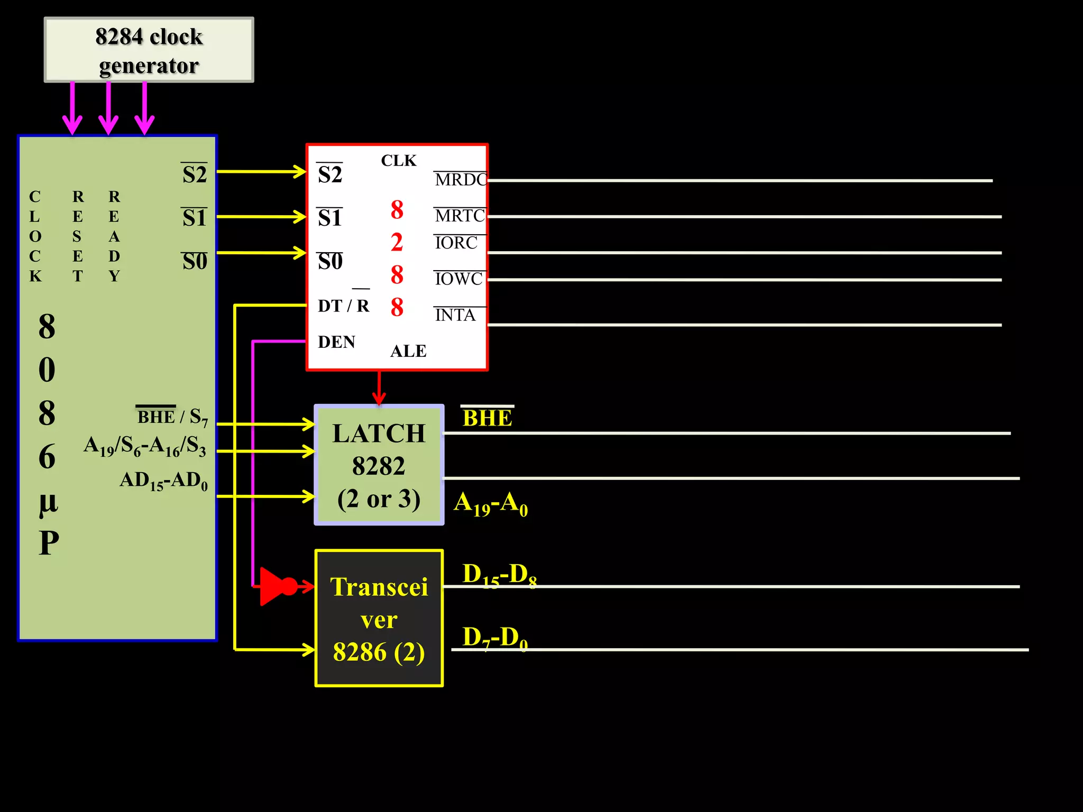

Slide 45
Design following system with 8086 microprocessor :
1.8086 working in minimum mode with 8 MHz
2. 64 KB EPROM using 32KB EPROM
3.128 KB RAM using 64kb RAM
Solution :
In memory interfacing we need to interface four categories of lines.
Address Lines
Data Lines
Control lies
Chip Select

